Slide 1
Lecture 11 Part 2 Back Propagation
Abrar Hasan
Lecturer
Dept. of Software Engineering

Slide 2
1
Back Propagation
<
T
1
>

Slide 3
Back Propagation
<
T
1
>
Remember Gradient Descent?
Gradient descent is an optimization algorithm commonly used to train machine learning models and neural networks.

Slide 4


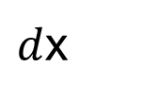

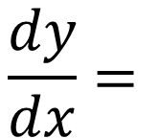
Chain Rule
<
T
1
>
$$\frac{dy}{dx}=$$
$$dy$$
$$da$$
$$da$$
$d$x

Slide 5
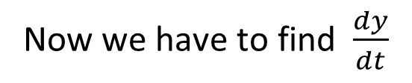
Chain Rule
<
T
1
>
y = 5x + 3
x = t²
Now we have to find $\frac{dy}{dt}$

Slide 6
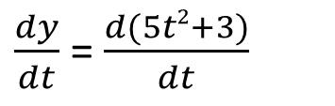
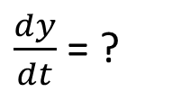
Chain Rule
<
T
1
>
y = 5x + 3
What generally we do,
x = t²
$\frac{dy}{dt}$ = ?
y = 5x + 3
= 5(t²)+3
= 5t²+3
$\frac{dy}{dt}$ = $\frac{d(5t2+3)}{dt}$
=10t

Slide 7
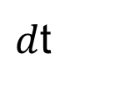
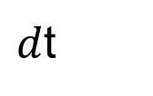
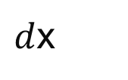
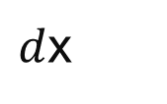

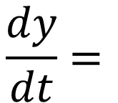

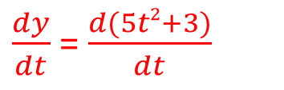




Chain Rule
<
T
1
>
y = 5x + 3
But in chain rule we see
x = t²
Y is function of X
X is a function of T
$\frac{dy}{dt}$ = ?
Instead of doing this
$$\frac{dy}{dt}=$$
$$dy$$
$d$x
$\frac{dy}{dt}$ = $\frac{d(5t2+3)}{dt}$
$d$x
$d$t
$$d$$
$$d$$
$$=$$
$$\left(5x+3\right)$$
*
(t²)
$d$x
$d$t
=5 *2t = 10t

Slide 8
<
T
1
>
W1
W7
W10
W2
W11
D Dimensional Input
W3
W8
W12
W4
W9
W5
W5
W6
W13

Slide 9
<
T
1
>
W1
W7
W10
y₁
W2
W11
W8
W12
D Dimensional Input
W3
W4
W9
W5
W5
W6
W13
Total Error = $\frac{1}{2}$(T₁-outy₁)² + $\frac{1}{2}$(T₂-outy₂)²+ $\frac{1}{2}$(T₃-outy₃)²
Outy₁= activation(w₁₀x₁+ w₁₁x₂)

Slide 10
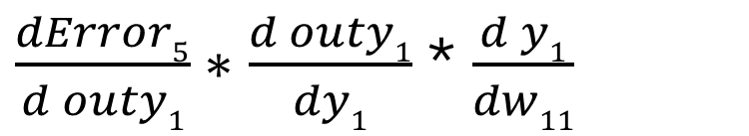
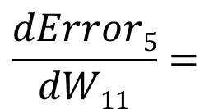
<
T
1
>
$$\frac{dError5}{dW11}=$$
$\frac{dError5}{d outy1}∗\frac{d outy1}{dy1}$ * $\frac{d y1}{dw11}$

Slide 11
Thank You

